Slide 1
Predict House Prices: Denton County
Predict House Prices for Denton County as Phase 1. Implement the model for all of US as part of Phase 2

Slide 2
Project Goal
Predict House Prices
The primary goal of this project is to forecast house prices for Denton County.
Identify key attributes
Determine main attributes that influence real estate prices.
Insights
Build a property valuation tool that offers insights for home-owners, government, financial institutions and investors.

Slide 3
Problem Statement
There are multiple models currently used by realtors, government and financial institutions to price a home at time of sale or appraise the value of a home.
What is missing is one model that everyone can access not only to understand the value of their home but also predict future values to assist investors and homeowners make decisions on whether to sell now or in the future.
This could be an alternative option for buyers and sellers to not only understand the value of homes but also compare how the value gets impacted by different factors such as: Living Area, Lot Size, City, Pool, Number of Bedrooms, Age of the house etc.
Tools like Zillow are at 93% accuracy. If we can build a model with higher accuracy, it can be a viable product that can compete with the existing tools.

Slide 4
Data source
Data of houses sold in Denton County in the last 90 days downloaded from MLS (database of all houses sold maintained by real-estate agents).
The data has 3348 observations and 31 columns including Close Price, List Price, Living Area, Land Size, Number of Bedrooms, Number of Bathrooms, Address, Subdivision, School District, names of High School, Middle School and Elementary School, Year Built, Flooring Type, parking spaces, Waterfront, Pool etc.

Slide 5
Data Cleanup and Transformation
Removed columns not needed:
MLS ID, Type (all were Single Family Homes), Address, Status (all were Closed), Standard Status (all were Closed except 1 which was showing as pending because the status probably was not updated).
Missing Values:
Removed Waterfront and Parking Spaces since most of the observations had missing values (Waterfront: 2286 missing values and Parking Spaces: all were missing)
Zero and Negative Values:
70 records for Acres and 1 for Bedrooms with 0 value deleted. 6 records that show Days on Market<0 removed.
New Features Added:
Price/SqFt, Age of the House, Sale Price as a % of List Price

Slide 6
Numerical vs Categorical Features
Numerical
Categorical
Pool
School District
Ordinal
Bedrooms
City
Bathrooms
Age
Days on Market
Living Area
Acres
Sale Price
Price/SqFt
Sale Price/List Price

Slide 7
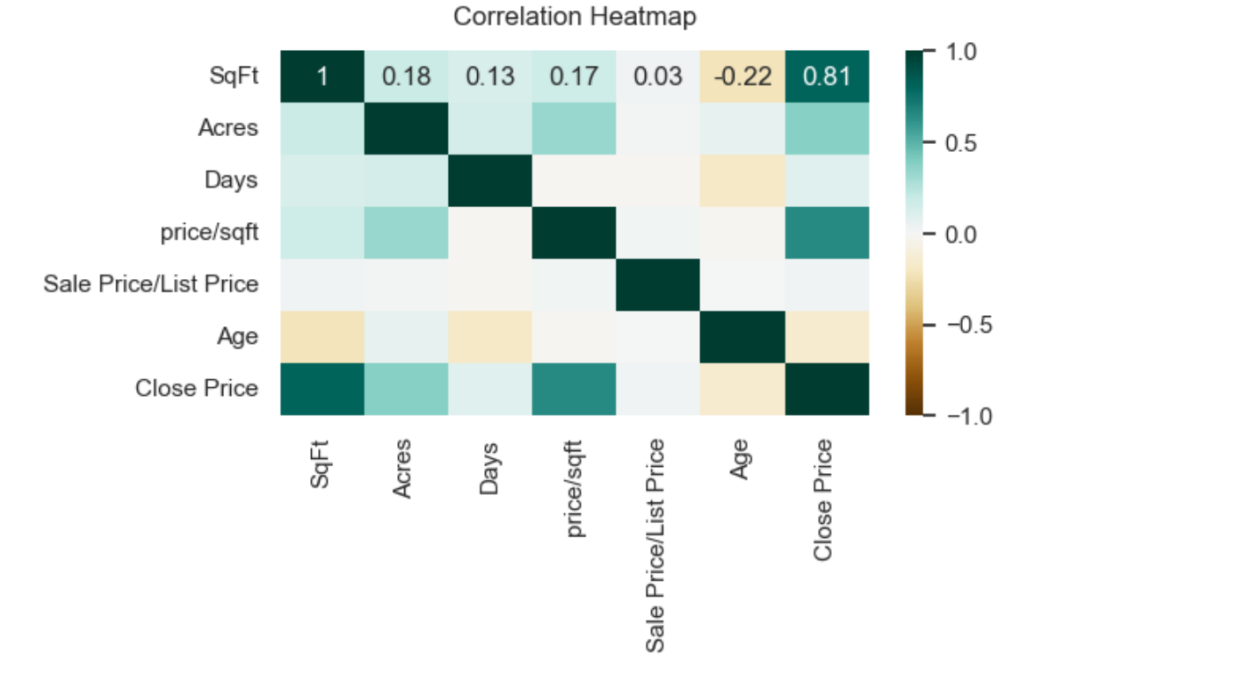
Heatmap: Numerical Features
Strong correlation between Living Area(SqFt) and Close Price.
Moderate to weak correlation between Age, Days and Close price.

Slide 8
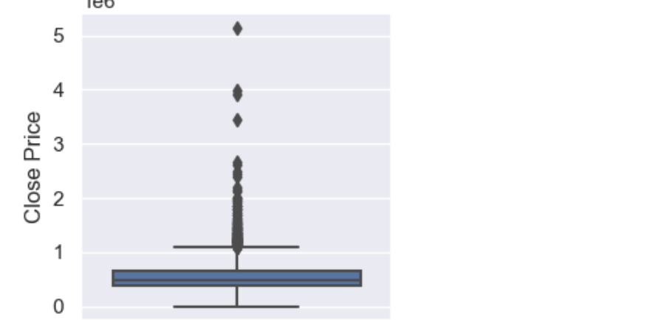



Boxplot: Sale Price
Outliers deleted
Outliers: > 5 Acres removed

Slide 9
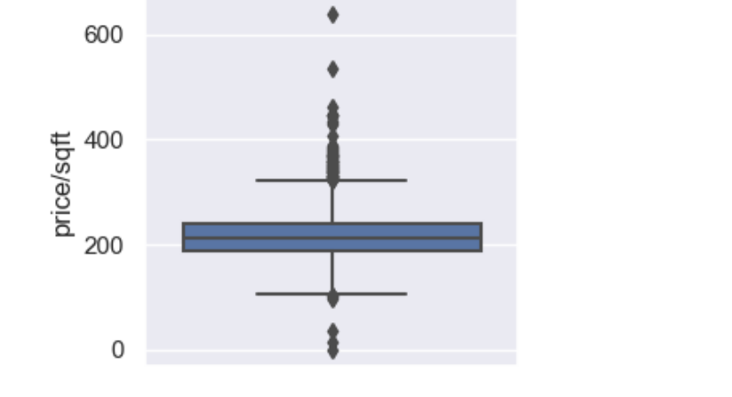
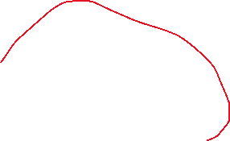

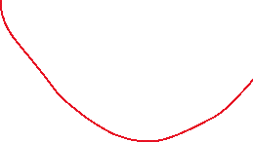
Boxplot: Price per SqFt
Outliers: Price/SqFt > 450
Outliers: > 5 Acres removed

Slide 10
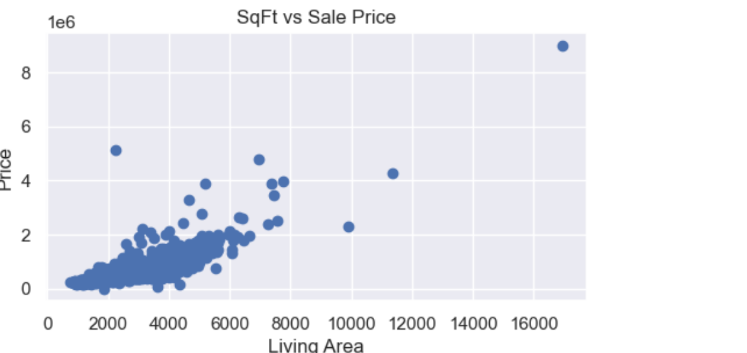

Sale Price and Living Area
Outliers: living area > 8000 SqFt.
Strong correlation between Close Price and Living Area.

Slide 11
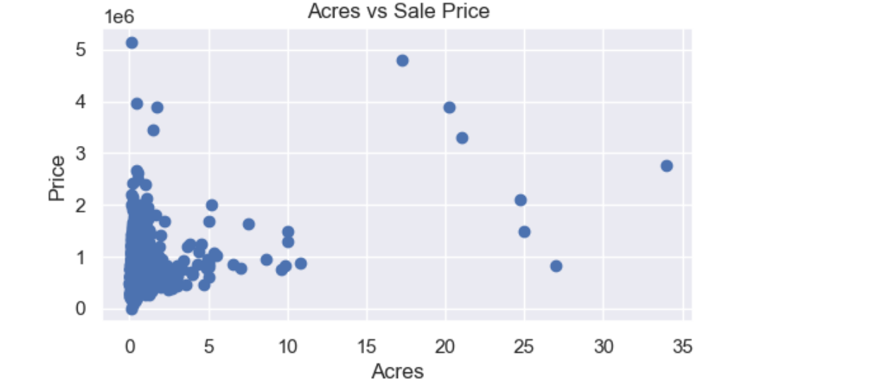

Sale Price and Acres
Outliers: > 5 Acres removed

Slide 12
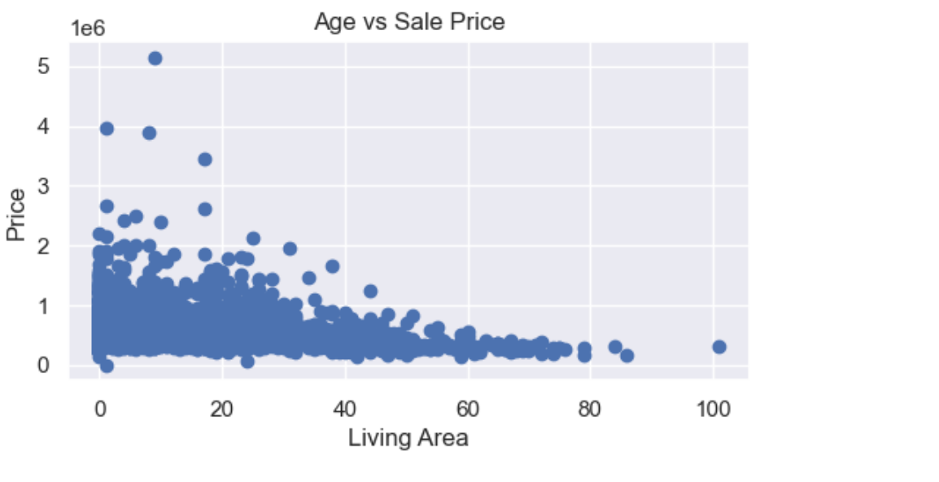

Sale Price and Age of the house
Outliers
Weak correlation between age and Close Price
Outliers: > 5 Acres removed

Slide 13
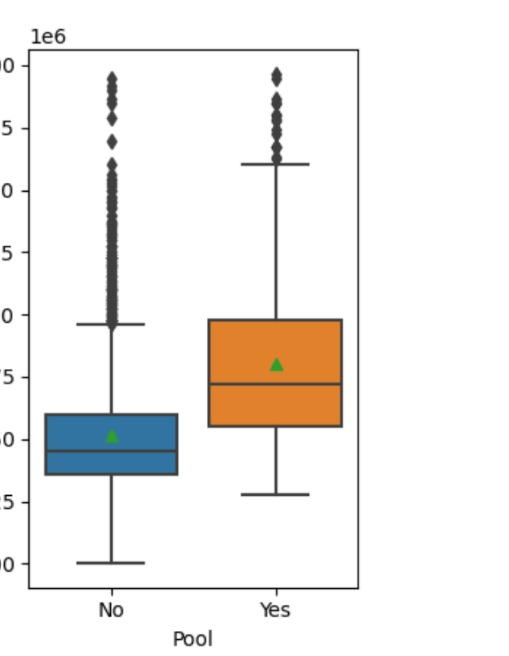
Impact of Pool on Prices
 | With Pool | Without Pool
Price / SqFt | 240 | 214
Sale Price | 804k | 514k

Slide 14
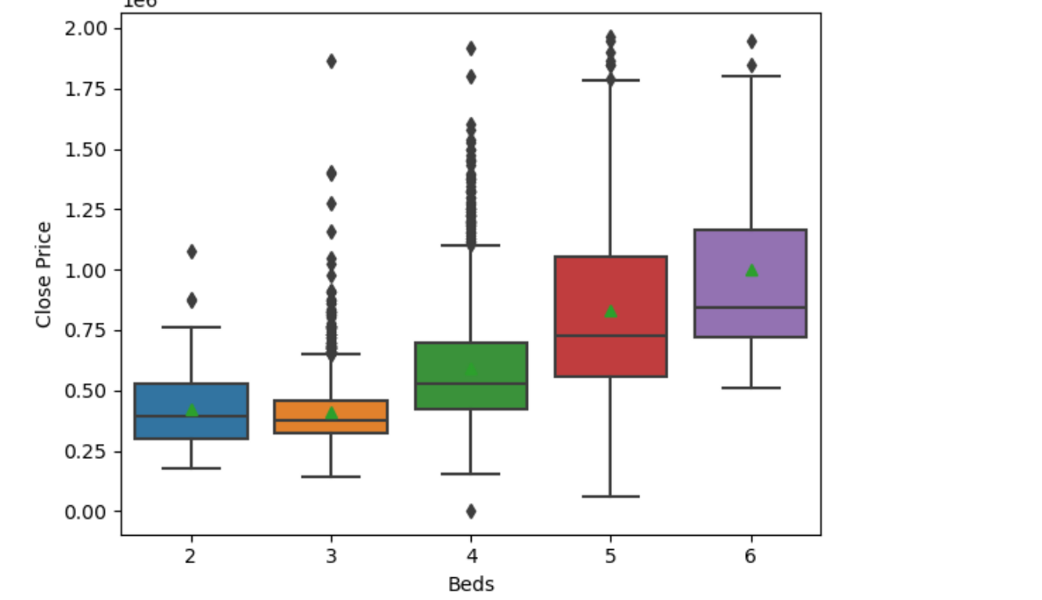
Impact of Number of Bedrooms on House Prices
Definite increase in mean Sales Price as number of Bedrooms increase.
There were very few (1 to 3) observations for homes with 1,7,8 and 32 bedrooms so deleted those.

Slide 15
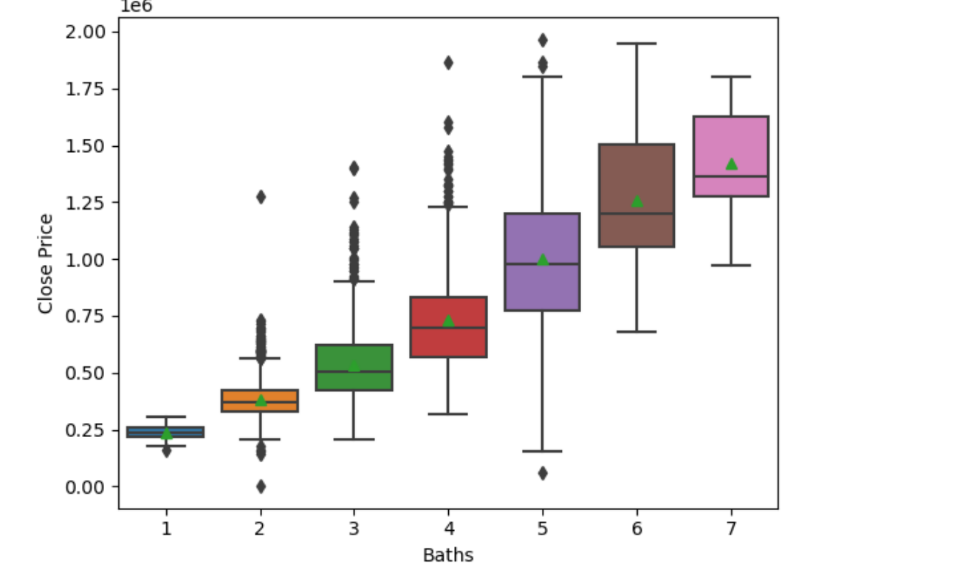
Impact of Number of Bedrooms on House Prices
Definite increase in mean Sales Price as number of bathrooms increase.

Slide 16
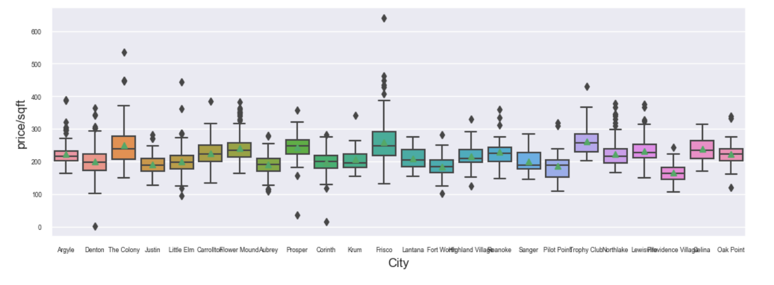
Impact of School District/City on Sale Prices
Some Variance in mean due to cities

Slide 17
Prediction Models: Set up and Evaluation
Setup:
80% of the data used for training and 20% for test.
Model | Features | Training Accuracy | Test Accuracy | Hyper parameters
Linear Regression | SqFt, Acres, Age, Beds, Baths, Pool, City | 80.2% | 79.6%
KNN | SqFt, Acres, Age, Beds, Baths, Pool, City, Days, School District | 82.6% | 68.7%
Decision Tree | SqFt, Acres, Age, Beds, Baths, Pool, City, Days, School District | 89.1% | 74.5% | Max Depth: 10, Min Samples Leaf:4, Min Samples Split = 10
Random Forest | SqFt, Acres, Age, Beds, Baths, Pool, City, Days, School District | 88.9% | 81.2% | No. of Trees = 100
Boosted Tree | SqFt, Acres, Age, Beds, Baths, Pool, City, Days, School District | 95.1% | 87.3% | Max Depth = 5

Slide 18
Summary
Problem Statement:
Predict House Prices for Denton County
Motivation:
Did a project in Data Miming course where I came up with 81% accuracy. Now with a much stronger understanding of ML models wanted to see if I can improve on the basic analysis and predictions I did before.
Dataset:
Houses sold in Denton County for last 90 days downloaded from MLS Website
Features Identification:
Based on correlation and statistical analysis, Living Area(SqFt), Land size(Acres), number of Bedrooms, number of Bathrooms, Age of the House, Pool and City identified as strong predictors and Days on the Market & School District identified as weak predictors.
Data Modeling:
Best results with Boosted Decision Trees which gave 87.3% test accuracy.

Slide 19
Next Steps
Added features to help get accuracy close to 95%:
School Ratings (on a scale of 1 to 10. Need to identify a dataset)
Quality of the House: Include features such as fireplace, garage area, basement, quality of the home: flooring, upgrades, kitchen quality, solar panels etc.
Work with real estate agents to understand what are the added features for which buyers pay additional over the market value and see if they can be included.
Expand to US
Once 95% accuracy is achieved, expand to include all the US data. Zillow is currently at 93% accuracy. Need to get close to 95% for this to be a strong alternative to the existing tools.

